Slide 1


MACHINE LEARNING 101
Nabaruna Guha
Data Scientist
EMEA Services
Notes:
Welcome to Machine Learning 101. In the previous trainings, we have understood the basics of Data Science along with data exploration and Data cleaning, We got to know about different types of data; structured, unstructured and semi-structured data. We learnt about relational databases, we learnt how to analyze and visualize tabular data and draw inferences from them.
In this presentation, we will dive into the world of machine learning, what it is and what all it can do.

Slide 2
CONTENTS
Introduction
Automation vs Machine Learning
What is Machine Learning?
Is Machine Learning a Black Box?
Artificial Intelligence vs Machine Learning
Why the Hype?
Requirements for Machine Learning
Predictions vs Decisions
Juniper Use Cases
Notes:
By the end of this presentation, we will know what machine learning is, how it differs from automation and Artificial intelligence, understand the requirements and reason of hype behind it and finally see some examples of applications within Juniper.

Slide 3
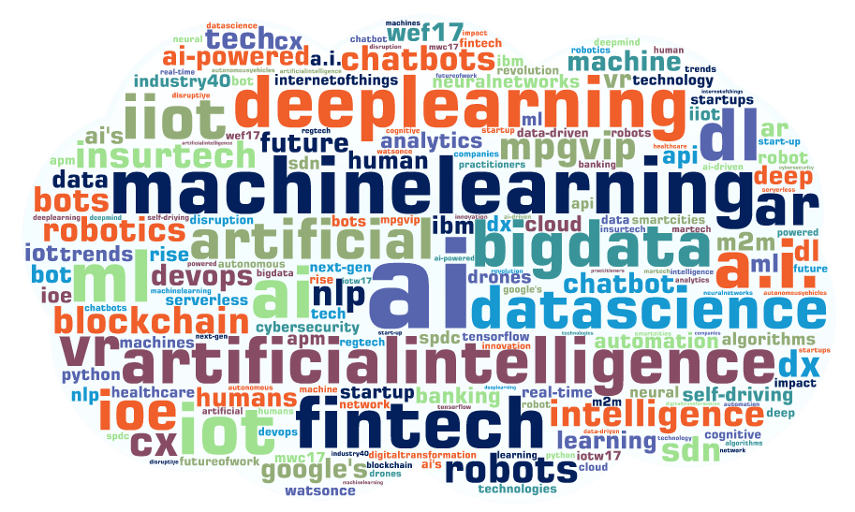
INTRODUCTION
Word cloud of words related to “AI” taken from tweets, blogs, publications, brands by top 100 influencers by Onalytica, an influencer marketing platform.
Notes:
We all know these buzzwords like ai, machine learning, bigdata, deep learning etc. Some of us have heard this words, some of us have dived a bit deep to understand them. And all of us agree that there’s a lot of hype regarding these technologies or concepts but what does even these imply? What is it this machine learning that everyone talks about? What does it do? What is the concept behind it? How do we use it and when and where? Or Do we really need it in the first place?
This presentation is about debugging and understanding what makes ML such a “talked” term, and what impact it can have on an organization.

Slide 4
1. Automation vs Machine Learning?
Notes:
A lot of times, we hear ML is applied to automate this and that process. And often some confusion lingers, are ML and automation the same?
Before we define machine learning in detail, let’s get it cleared how it differs from automation.

Slide 5

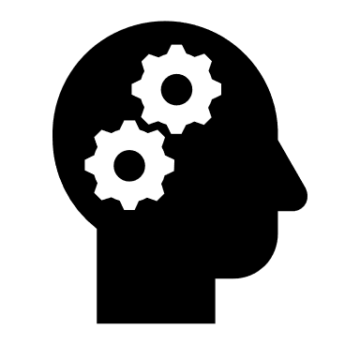
AUTOMATION VS MACHINE LEARNING
AUTOMATION
Designed to streamline tasks and speed workflows
Rule-driven
Fixed on repetitive, instructive tasks
Performs a job, and then thinks no further
MACHINE LEARNING
Designed to build models to take decisions based on past data
Data-driven
Identifies data signals relevant for the future
Machine learning takes the automation tasks and layers them in an element of prediction
Notes:
Most of the automation which has happened in the last few decades has been rule-driven automation. It is designed to streamline tasks and speed-up workflows.
On the other hand, machine learning helps machines learn from past data and take decisions or change their performance according to what it learns from the patterns in data. So, unlike automation, ML is data-driven.
Automation is fixed on repetitive and instructive task which means it would continue to do exactly as you requested it to do.
Whereas, machine learning takes the automation tasks and layers in an element of prediction over it.

Slide 6


AUTOMATION VS MACHINE LEARNING
SOME EXAMPLES
AUTOMATION
Automating emails to customers
Automating the way you generate invoices
Automatically logging a helpdesk inquiry
MACHINE LEARNING
Spam detection in our mailboxes
Predicting when the invoices should go out, who did or did not receive one, when payments are on the verge of being late, and so forth.
Chatbot to answer helpdesk inquiries
Notes:
Let us understand this using some simple examples.
Automation is automating flows in our mailbox and it needs us to define the rules for it. These rules act in the same manner every time.
Another example is Sending invoices on a specific day or automatic logging a helpdesk inquiry like setting-up an automated dial-in response when one calls the customer service
Whereas, Spam detection in our mailboxes is driven by machine learning. It is not always perfect, but if it puts the wrong email into spam and you tag it as “not a spam”, the algorithm used will learn from this info and will give it’s best not to repeat this mistake and thus, it continues to evolve with time. Sending invoices on a specific day is automation but deciding who should get one and who shouldn’t and when should one receive it and so forth depending on one’s status is what machine learning can do.
A chatbot is a ML example as well, the machine is fed with thousands or millions of conversation examples for it to learn from them and based on that it predicts interactive responses.

Slide 7
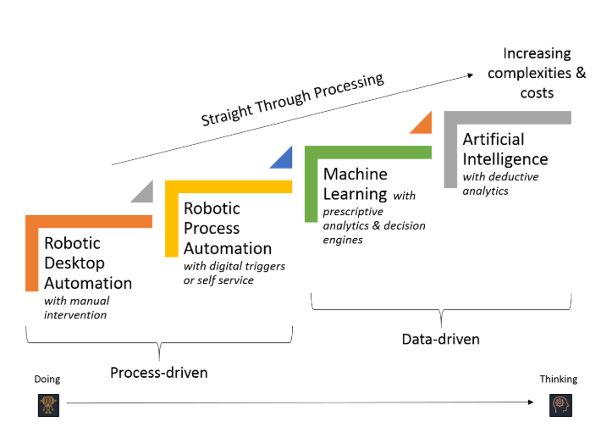
AUTOMATION VS MACHINE LEARNING
AUTOMATION is associated with “doing” whereas AI and ML is concerned with “thinking” and “learning” respectively.
Notes:
A step-by-step processing methodology from process-driven approach to data-driven approach.
How automation is stepped-up to artificial intelligence
We can say automation is associated with “doing” and machine learning or ML goes a few steps forward in making machines/computers “think”

Slide 8
2. What is Machine Learning?
Notes:
In this section, we will deep dive into what machine learning really is.

Slide 9
WHAT IS MACHINE LEARNING?
“Machine Learning is the science of getting computers to learn and act like humans do, i.e. learning from observations and real-world interactions and making predictions/determinations based on that learning and improve their learning over time in autonomous fashion.”
-Just like we humans observe our surroundings and learn from it and if we learn something wrong, we in turn learn from our mistakes. The same way, machine learning lets machines improve their learning over time in autonomous fashion, by feeding them data from time to time. : Learning of Machine
Notes:
There are a lot of definitions provided by the top notch in this field and these different definitions can be interpreted depending upon one’s understanding.
If we look for a one inclusive definition that explains the whole essence of ML that’d be ….. “Machine Learning is the science of getting computers to learn and act like humans do, i.e. learning from observations and real-world interactions and making predictions/determinations based on that learning and improve their learning over time in autonomous fashion.”
-Just like we humans observe our surroundings and learn from it and if we learn something wrong, we in turn learn from our mistakes. The same way, machine learning lets machines improve their learning over time in autonomous fashion, by feeding them data from time to time; the machine is continuously learning and thus the name.
With machine, we not necessarily mean a robot, it can be just a software program.

Slide 10

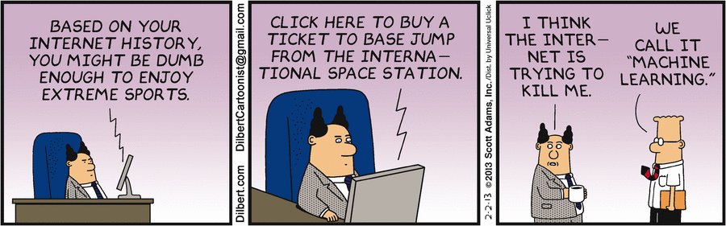
THEY ARE WATCHING YOU
Notes:
In our day-to-day life; the things that we search on Google, click links from different social media platforms, read or watch on the web: Everything is potential food for the machine learning to kick-in. Once it gets the food, it gives us recommendations in terms of ads, i.e. technically that’s how Facebook became a multi-billion company and no user even ever paid to have an account on Facebook.
Online recommendation offers, such as those from Amazon and Netflix are examples of Machine learning applications in everyday life.
Knowing what customers are saying about you on social media platform like on Twitter, this is an example of Machine learning combined with linguistic rule creation.
So, this targeted online marketing or product recommendation on e-commerce sites etc are very popular examples of what machine learning can do. And that is done using the big big amount of data present online, from different platforms to keep consumers hooked to their product. So, as long as there is data, machine learning will make use of it to earn from it.

Slide 11
3. Is Machine Learning a black-box?
Notes:
So, is ML a black-box?

Slide 12

IS MACHINE LEARNING A BLACK BOX?
Set of algorithms or statistical models designed to perform a specific task without using explicit instructions but relying on patterns and inference instead.
Notes:
We can say this black-box (as some would like to call it) is a bunch of computational statistics which focuses on making predictions using software programs. But we as the users of this black-box just don’t need predictions for the sake of it; we want answers to our use-cases or problems that may seem impossible to work on with conventional programming. Data scientists/ML engineers don’t consider it as a black-box because the ML models are interpretable; these black-box deemed methods pave ways for industries to take decisions based on the data they own. Those decisions can be related to their customers or their products, it can be about getting new customers, providing new innovations or retaining their old customers and maintaining their existing products.

Slide 13
4. Artificial Intelligence vs Machine Learning?
Notes:
Let us head towards understanding the difference or let’s say relationship between AI and ML. Because a lot of you might have heard both of these terms frequently and often see/hear people using them interchangeably.

Slide 14
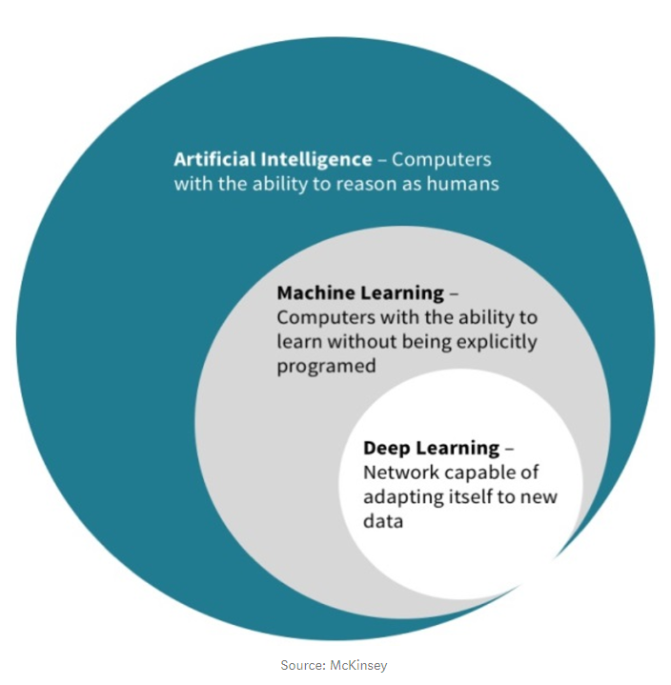
ARTIFICIAL INTELLIGENCE VS MACHINE LEARNING
Artificial Intelligence is a broader class which includes Machine Learning.
Deep Learning is part of the broader class of Machine Learning based on artificial neural networks.
Notes:
Just like Machine learning or ML, Artificial intelligence or AI is a huge buzzword and is mentioned every now and then. AI is, as the name says, intelligence that is artificially produced. AI is the ability that computers can reason as humans.
AI, ML; these concepts go hand-in-hand and go quite some time back.
Idea of AI goes back to the 1950s.
And it was in the 1980’s, ML began to grow in popularity
This diagram is by McKinsey and it successfully classifies AI from ML. We can see in this diagram; AI is a broader class which includes machine learning.
Further down, we can see Deep learning as a subset of Machine learning. DL is based on artificial neural networks, and DL started to drive AI to more advancement in the 2010’s.
These concepts are linked as subsets where DL drives ML and then both together ultimately enable AI.
So, the main takeaway from this section is “Machine Learning (ML) is a subset of Artificial Intelligence (AI)”

Slide 15
ARTIFICIAL INTELLIGENCE VS MACHINE LEARNING
Artificial Intelligence is the concept of performing tasks by machines that usually require human intelligence.
The idea that machines can mimic human cognition while performing tasks and act to maximize chances of success, comes under the broader category of AI.
How AI disrupts the different industries and help reinventing the companies?
AI is not magic
AI is not magi
Media sometimes paints an unrealistic picture of the AI prowess.
But AI is already transforming some sectors like web search, advertising, e-commerce, finance, logistics, media, and more.
Examples: Personal assistants like Siri & self-driving cars etc
AI is not magic
AI is not magic
Notes:
Understanding the difference and relationship between these two, a bit more in detail:
We can say AI is the concept of performing tasks by machines that usually require human intelligence.
The scope of AI is often disputed and constantly changing over time.
The systems implemented today are a form of narrow AI - a system that can-do tasks as good as or even better than the humans. This narrow-AI has been driven by deep learning technology (A further subset of ML) and it is not MAGIC as media sometimes paints an unrealistic picture of the power of AI.
AI is already transforming sectors like web search, advertising, e-commerce, finance, logistics, media and so many more
Nowadays, AI is able to recognize objects/gestures/speech/sentiment Or even generate objects/patterns etc just like a human would do.
Personal assistants like Siri & self-driving cars etc are some popular and common examples of what AI has achieved

Slide 16
ARTIFICIAL INTELLIGENCE VS MACHINE LEARNING
MACHINE LEARNING or ML is an approach to reach the level of AI learning from experience (data).
Machine learning is framed inside the artificial intelligence, and it is a field focused on making a computer capable of learning on its own in order to make an specific task, instead of giving it the exact order to achieve the task.
The knowledge obtained by the computer during the learning process is reflected in what is known as machine learning model.
DATA + LEARNING METHOD + EXAMPLE RESULTS = MODEL
AI is not maAI is not magic
gic
MODEL
Piece of software ready to issue predictions on unknown data
Notes:
And as for Machine learning, we can say…. ML is an approach to reach the level of AI, learning from experience (i.e. data).
As we have seen, ML belongs to AI and this field focuses on making computers/machines learn on their own rather than assigning it tasks in a particular order to achieve them.
The knowledge that the machine obtains during the learning process is what we call a model or a machine learning model.
So, model is a piece of software ready to implement predictions on an unknown data.
Examples would be Recommendation engines & fraud detection etc.
We can say, the AI products, Siri and self-driving cars are built on several ML algorithms for their different functionalities.
One thing, important to mention is that: We are talking about data all the time here. Data doesn’t need to be necessarily just excel sheets or relational tables: it can be unstructured text data, data gathered from clicking different webpages in the internet, it can be even image data or voice data, it can be image of text-data. It can be data in practically any form.

Slide 17
5. Why the hype?
Notes:
Why is there, a huge hype for it? Why is everyone talking about it, using it or planning to use it?

Slide 18
WHY THE HYPE?
Machine Learning is a “buzzword” but how useful it really is?
UTILIZE ALL THE DATA AVAILABLE
SOLVING DATA VOLUME FROM MULTIPLE SOURCES AT SCALE
RECOMMENDATION
AVAILABILITY OF HUGE VOLUMES OF DATA
Crucial challenge for business to do it.
So that it is both meaningful and actionable or even monetize from the data available.
Useful & efficient in cases when the outcome is influenced by several chunks/sources of data.
Such problems cannot be crunched effectively at scale by humans.
To predict the right set of product mix for the customers
Implementing a sentiment analysis by processing written review or descriptions across different platforms to determine customer behavior across multiple touchpoints.
AI is not a new concept
However, it has now become a viable business solution mainly due to big data generated by us and the emergence of cheaper, faster machines.
Notes:
1. One of the most crucial challenges for businesses is learning how to utilize all the data available to them in a way that is both meaningful and actionable or even monetize from it.
2. Machine Learning proves useful & efficient in cases when the outcome is influenced by several chunks of data which cannot be crunched effectively at scale by humans. It hence solves for scale & data volume from multiple sources.
3. Building recommendations systems. E.g. Implementing a sentiment analysis by processing multiple social media feeds across different platforms or determining buying behavior across multiple touchpoints to predict the right set of product mix
4. And on top of everything, the large amount of data is present everywhere
Artificial Intelligence is not a new concept. However, it has now become a viable business solution mainly due to the availability of huge volumes of data generated by us and the emergence of cheaper, faster machines.
A machine learning algorithm does not require a supercomputer anymore. Computing power has finally caught up to the point where even handheld devices have dedicated ML hardware.

Slide 19
6. Requirement for Machine Learning
Notes:
It is the time to understand what are the requirements for implementing Machine learning methodology/approach in an organization.

Slide 20

REQUIREMENTS FOR MACHINE LEARNING
Machine Learning changes the way one thinks.
Traditional approach:
Machine Learning approach:
Machine Learning has the ability to think like a Scientist and lets one explore the areas that were impossible to think of in the past.
Logical and mathematical think
Understand the problem
Apply logic to find a solution
Statistic analysis and pattern inference
Find the relevant data to analyse
Design a model able to find the desired conclusions from the data
Notes:
Before we dive into the requirements, it’s worth mentioning the difference in approach of traditional programming to the ML one, first.
Traditional approach is based on logic and mathematical understanding
Whereas ML approach is based on statistical analysis, probability distribution and pattern inference of the input data.
i.e. ML is about Focusing on statistics more than on logic steps.
An ML model is generated based on experimentation (rather than on a reasoning based on requirements)

Slide 21



REQUIREMENTS FOR MACHINE LEARNING
Machine Learning requires a lot of relevant data
How much is “a lot”?
Depends on the problem!
More data
Well...
Better model
Better predictions
Notes:
Machine learning requires a lot of relevant data but how much is “a lot” exactly?
It totally depends on the problem.
The more data we have, better the machine learning model and better predictions it can give us.
Usually,
- Thousands of examples for basic linear models.
Hundreds of thousands for neural networks (Deep Learning).
The mindset should not be how one can implement machine learning to solve a problem, the mindset should be, if we have a use-case or problem statement and to solve that, and one is hitting a hard-wall using traditional programing methodology, what about exploring ML technologies opportunities to check if this can be of help to us.

Slide 22



REQUIREMENTS FOR MACHINE LEARNING
Data collected specifically for the task in hand is going to be the most useful
If specific task-centric data is not available, take close enough lot and keep check on the cost depending on product logs
If the amount of data is less, a non-ML solution should be considered first.
Notes:
Some points that are important to keep in mind before adopting ML approach.
One has to ensure that:
1. Data collected specifically for the task in hand is going to be the most useful
2. If specific task-centric data is not available, one should take close enough lot and keep check on the cost depending on the product logs
3. If the amount of data is less, a non-ML solution should be considered first.

Slide 23



REQUIREMENTS FOR MACHINE LEARNING
For an organization to be benefitted from ML, it is important for the organization to:
Adopt the culture of a data-driven approach
Inculcate the habit of storing data in a structured, robust and centralized form
Focus on assuring data quality from the generation stage (Can save hours of post-processing time)
Notes:
From the organization perspective, it is important to focus on a few points if one plans to adopt ML methodologies:
The essence of ML is data; and on top of that, good quality of data.
As it has been mentioned before, ML or AI is not magic. One cannot feed a model with lots of data to get fancy outcome/predictions out of it.
And for that purpose, it is important for the organization to:
Adopt the culture of a data-driven approach
Inculcate the habit of storing data in a structured, robust and centralized form that is where Relevance of a centralized database or data storage comes into question.
Data quality should be assured from its generation stage to save time from unnecessary pre and post processing: Relevance of having a collaborative and centralized data science platform comes into question.

Slide 24
7. Predictions vs Decisions
Notes:
We have been talking about predictions that machine learning make predictions but is it the same as taking decisions?

Slide 25


PREDICTIONS VS DECISIONS
Predictions allow us to take a useful actions/decisions
The ML model gives us prediction for us to take decisions taking inference from the prediction.
E.g. YouTube wants to predict if a video uploaded will become popular in the future.
Predicts the likelihood of clicking certain videos
Prefetch the videos most likely to be clicked/Most popular
ML help “empower business decisions”.
Different decisions can be taken from the same model prediction.
Notes:
One thing that is very important to note is that, Machine learning doesn’t make machines, take decisions for us.
They are just tools that make use of human knowledge in the form of data to support humans to take decisions.
In a way, we can say machine learning helps empower business decisions.
It provides outcomes to problems that might have not even imagined would be possible with traditional approaches, but it can never and will never replace humans in doing their jobs. ML comes into view when humans hit a wall with a problem or wants to make an existing process more efficient and faster so that humans can concentrate on other important tasks. In ML, the experiences of humans and their knowledge are taken, in the form of data, and based on that data, machine draws patterns between each data values, looks for dependencies, correlations etc and draws conclusions from those and present it to the humans as predictions.
Now, the predictions are used as support tools by humans to take important decisions
Here, we have an example of Youtube predicting if a video uploaded will become popular in the future or not, ML will predict the likelihood of clicking certain videos and decision must be made based on those predictions, like prefetching the videos most likely to be clicked will be the most popular one.

Slide 26
8. Juniper Use Cases
Notes:
Juniper is also not new to adopting the same either. There are projects/products where ML approach has been successfully implemented and there are use cases formulated across the organization where ML methodology adoption is undergoing or will be adopted soon.
In this section, we will highlight a few of the Juniper use-cases.

Slide 27


USE CASES WITHIN JUNIPER
JDA
HEALTHBOT
Juniper Digital Assistant (JDA) is 24/7 AI-Hybrid chatbot.
An efficient and real-time live chat channel for agents to interact with customers.
Saves time spent on common, high volume tasks by providing swift automated system responses.
Reduces Mean Time to Resolution (MTTR).
Based on Einstein-bot by Salesforce.
Learns from thousands of conversation examples and predicts responses in real-time based on that.
Network health and diagnostic solution providing consistent and coherent operational intelligence across network deployments.
Aggregates large volumes of time series telemetry data and provides a multidimensional view across network and applications, translating real-time analytics into actionable insights.
Applies machine learning to dynamically identify performance anomalies and outliers.
Notes:
The two most popular Juniper Use cases are JDA and Healthbot.
JDA or Juniper digital assistant is a 24/7 AI-Hybrid chatbot for enhancing customer support.
Hybrid chatbot because it makes best of agent and AI. It enables Agents/Engineers to focus on more complex customer issues by letting the AI part deal with trivial matters and the AI redirects to the agent if the issue is not known to it and is more complex.
Thus, it saves time spent on common, high volume tasks by providing swift, proactive response to the customer queries.
It is based on Einstein-bot by Salesforce, it learns from thousands of conversation examples and predicts responses in real-time based on the examples fed to it.
Healthbot is a network health and diagnostic solution which is designed to provide consistent and coherent operational intelligence across network deployments.
It aggregates large volume of telemetry data and provides a multidimensional view across network applications; translating real time analytics into actionable insights like prescriptive/predictive maintenance of the network devices.
ML is applied to identify performance anomalies and outliers e.g. When real-time metrics deviate from configured tolerance levels, machine learning proactively takes corrective actions against it.

Slide 28
USE CASES WITHIN JUNIPER (DEA - DATA SCIENCE)
Find Similar Cases
Identify JTAC cases with similar symptoms, resolution and root causes etc. for effective and useful troubleshooting and faster resolution
Case Escalation Prediction
Predict which cases are likely to be escalated based on the attributes to prevent it from happening by taking timely corrective action
Customer Retention (CS)
Predict if a customer will continue purchasing products & services from Juniper using customer interaction/product usage data to improve customer success
Case Knowledge Content Matching
Match information between new case description to existing knowledge content for proactive resolution. Implemented when customer is in process of creating a case or calling to ask for help: Case deflection
Notes:
Here are some data-science use-cases identified by the Data science practice team under DEA (Digital experience and Automation) where ML will play an important part to find solutions to these problems.
Finding similar cases:
Once new cases are created, identify other cases with similar symptoms, resolution and root cause by analyzing case data (which is mainly text data). This will lead to an effective handling of cases. When a JTAC engineer is handling a case, they will like to identify similar cases to that one (active/closed); so that they can troubleshoot them effectively and resolve them faster.
Case Escalation
Predict if a case will be escalated or not and why based on both technical/non-technical attributes. And this is to prevent case escalations by taking timely corrective actions.
Data: case data
Customer retention:
Predict if a customer will stay with Juniper based on customer interaction data and product usage data to gain insight into activities that will improve customer success.
Case Knowledge Content matching:
Also can be called case deflection: i.e. match info during creation of new cases to existing knowledge content so that resolution can be provided even before the case is created.
Data: KBs, technical docs.

Slide 29
USE CASES WITHIN JUNIPER (DEA - DATA SCIENCE)
Device/Network Failure Prediction
Analyze device telemetry data and identify anomalies for proactive issue prevention
Auto Populate Case Resolution Fields
Automating case related task to increase productivity and improve staff satisfaction
Notes:
N/W failure prediction:
Identify anomalies, recommend next action and perform manual/automated corrective actions using customer device data.
Auto populate:
Once a case is resolved, auto populating case closure fields for increasing productivity and satisfaction of internal staffs.

Slide 30
USE CASES WITHIN JUNIPER (ASCE - EMEA)
PIIR-PBN Classification
To classify whether a given PR taken from a PIIR report is a PBN or not.
For reduction of the gap between important PR’s from PIIR report and PBN report before releasing it to the customers by reducing human effort and making the entire process faster.
PR-Tagging
Tagging PR’s based on keywords taken from their description.
Use the tags to filter the PRs for diverse purposes like matching the tagged PR to it’s corresponding feature list in CFL.
Notes:
And then there are use-cases identified by the ASCE-EMEA team where implementation of ML methods are necessary to solve these problems:
PIIR-PBN classification:
To classify whether a given PR taken from a PIIR report is a PBN or not.
After GSAT completes a PIIR, the most important PRs are selected that have serious service impact to publish them as PBN.
But not all important PR’s are published as PBN. So, There is a “gap” between these important PR’s taken from the PIIR report and the PBN report.
ASCE engineers manually go through these important PR’s one by one to reduce this gap. Machine learning methods can be used to predict which PR is to be published as PBN and which is not and thus reducing a big chunk of time invested by the ASCE staff.
Tagging PR’s based on keywords taken from their description
Use the tags to filter the PRs for diverse purposes like matching the tagged PR to it’s corresponding feature/sub-feature in CFL. This is a very difficult task to be done manually and Machine learning has the ability to make this happen.

Slide 31
Summary
Machine Learning/ML is a concept that is data-driven
It is implemented when traditional programming technique hits a hard wall
It doesn’t replace humans but in turn empowers humans to take decisions
It also makes many processes easy, fast and efficient
Notes:
I will point out a few important points that we have learnt here:
Machine Learning/ML is a concept that is data-driven and is implemented when traditional programming technique hits a hard wall.
It doesn’t replace humans but in turn empowers humans to take decisions in ways that they couldn’t have thought in the past. It also makes many processes easy, fast and efficient so that humans can concentrate on harder and more delicate problems in hand (The juniper use-cases explained earlier are examples of the same)

Slide 32
Notes:
And here the ML 101 presentation concludes.
Next we will go to the machine learning 102 which will break down some important ML concepts and teach us how to adopt a ML mindset.

